Slide 1
French Bakery daily sales
(2021-01-02 to 2022-09-30)
Insights and Recommendations for Improving Sales & Marketing
Tripuraneni Gireesh Chowdary - 23948238

Slide 2
Basic Statistical Insights from the Dataset
Most customers usually purchase just one item per order, and this trend remains consistent throughout the entire period from January 2021 to September 2022. Orders generally take place between 7AM and 8PM, with the average transaction occurring in the late morning, showing a steady and predictable buying rhythm. Despite occasional bulk purchases reaching up to 55 items, single-item orders remain the clear norm, reflecting simple, quick, and routine customer behavior.

Slide 3
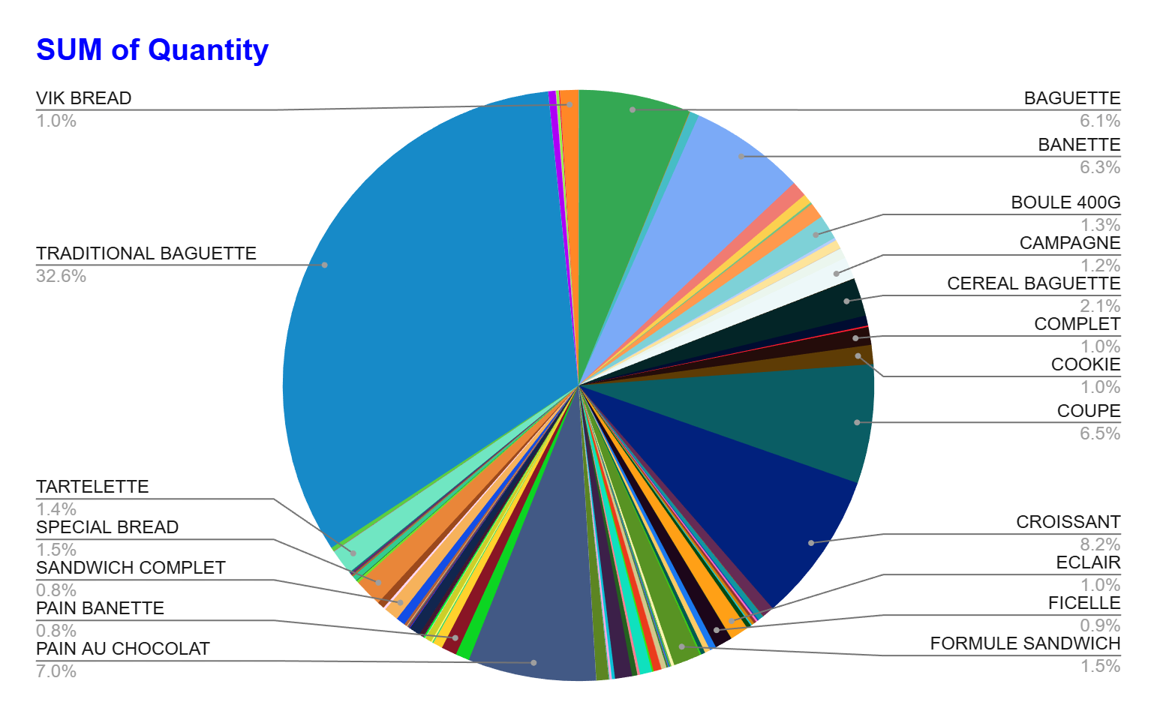

Traditional Baguette makes up nearly one-third of all items sold, far outperforming every other product in the bakery. Croissants, baguettes, and banettes also perform well, while many smaller products contribute only tiny percentages, showing where to focus production and promotion.
Promote Traditional Bread as the bakery’s signature best-seller.
Use croissants, baguettes, and banettes in bundles and upsell offers.
Reduce or rotate low-performing items to focus on high-demand products.
Run time-based promotions for morning peaks and afternoon slumps.
Boost visibility through social media posts and fresh-bake visuals.

Slide 4
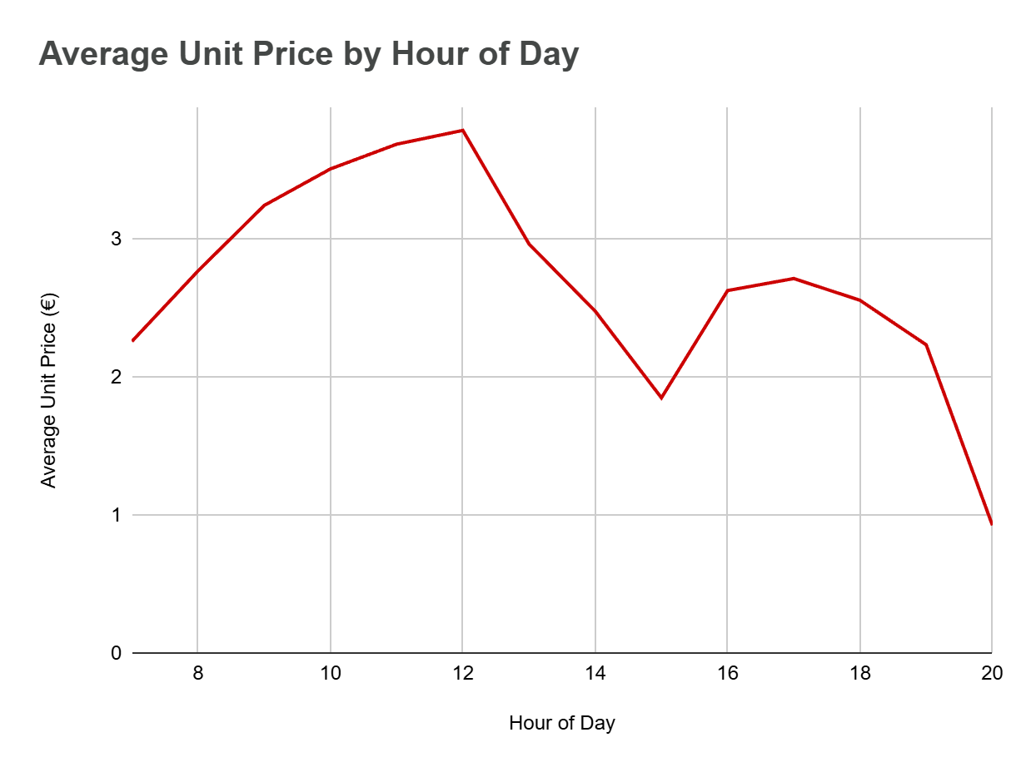
Pricing Trends Change With Time of Day
The average selling price increases steadily throughout the morning.
Pricing reaches its peak around noon.
Prices drop in the afternoon as customer choices shift.
Higher-value items are purchased earlier in the day.
Later hours show a preference for simpler, lower-priced items.

Slide 5
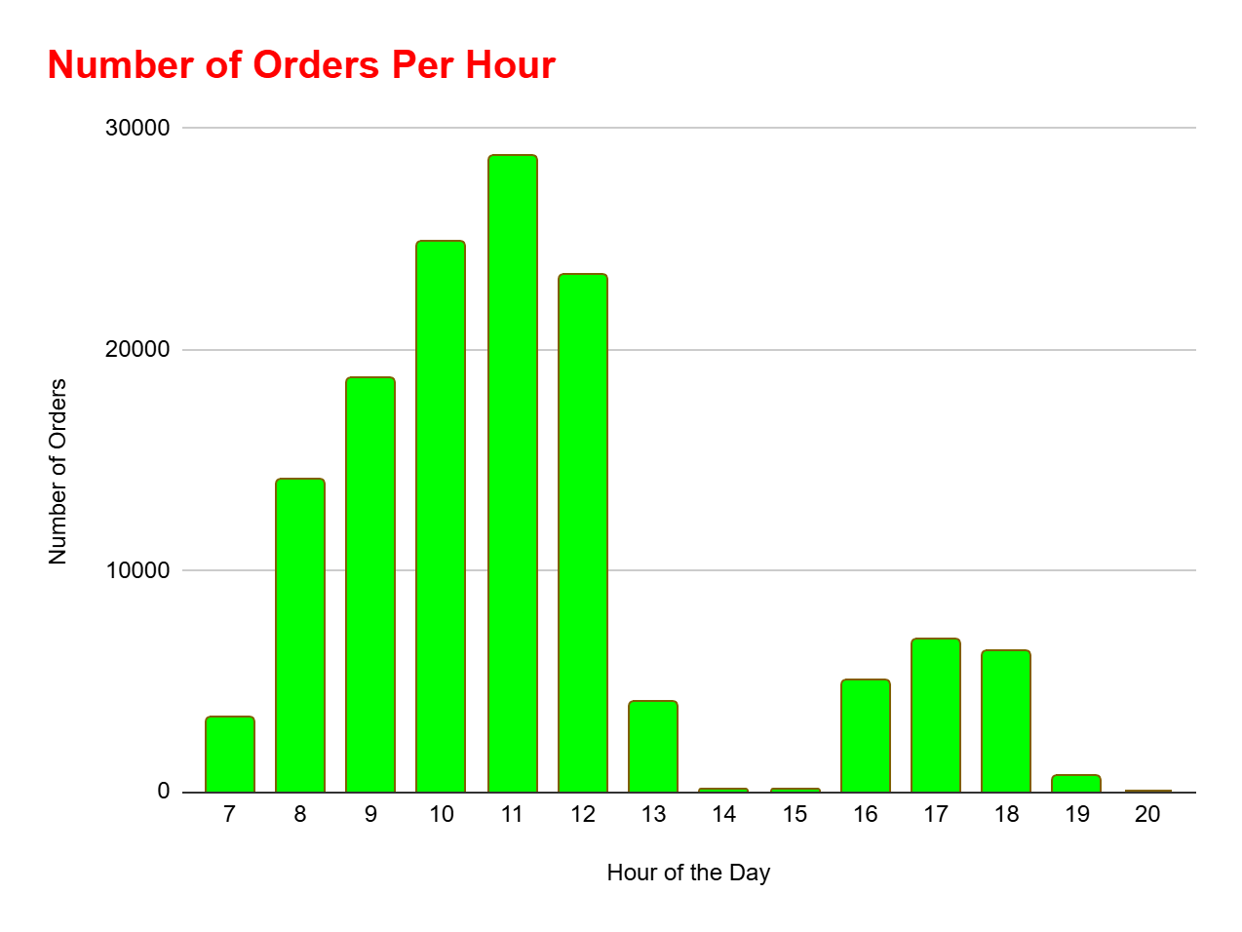

Number of Orders Per Hour
We see customer activity pick up quickly after 8 AM, and it reaches its highest point between 10 AM and noon. This late-morning rush is when the bakery is at its busiest, making it the perfect time to push quick-serve items, offer small add-on deals, and run short, well-timed promotions that help boost overall sales.
PEAK
LOW
Marketing Actions Based on Data Insights
promote our best-selling items like Traditional Bread and croissants more often.
use the busy late-morning hours (10 AM–12 PM) to offer combos and upsells.
run small tea-time deals in the slower hours (2 PM–4 PM and 7 PM-8 PM) to bring in more customers.
keep the menu simple by removing low-demand items and highlighting the popular ones.

Slide 6
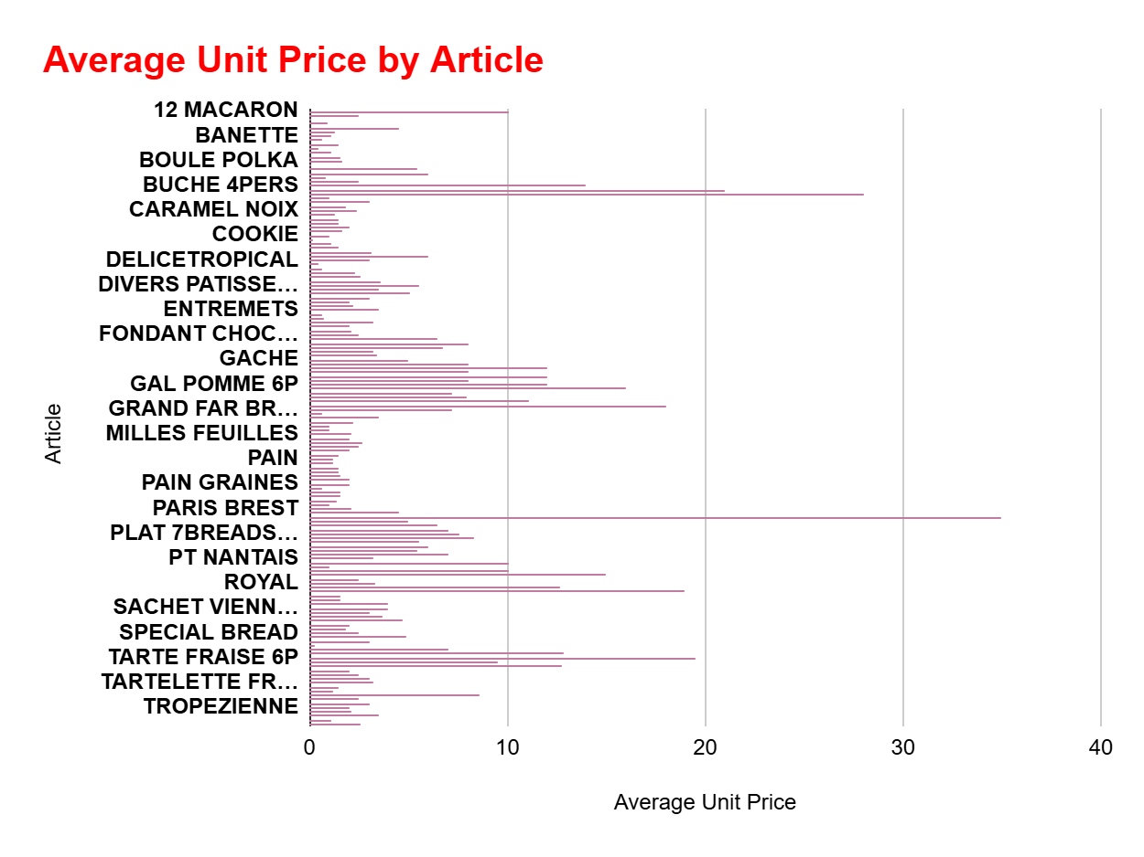
Most products sit in an affordable mid-price range.
A few specialty items are priced much higher.
This price spread gives us room to promote premium items more strongly.
Lower-priced items may need adjustment if they’re undervalued.
This mix shows that we have room to promote premium items more confidently and also rethink whether some of our lower-priced products are undervalued.

Slide 7
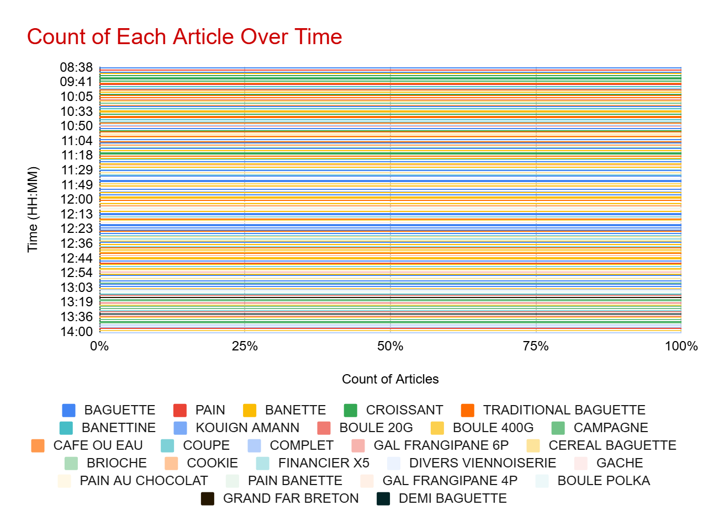
Product Consistency Throughout the Day
The mix of products sold stays almost identical from 8:38 AM to 2:00 PM, showing that customers consistently buy the same items regardless of the time. This steady pattern suggests predictable demand, making it easier to plan production and maintain stock without needing time-based menu changes.

Slide 8
How We Can Strengthen Our Marketing Campaign?
Focus on promoting our best-selling items like Traditional Bread and croissants.
Use the busy late-morning hours (10 AM–12 PM) for upsells and combo offers.
Run tea-time discounts during slower hours (2 PM–4 PM) to bring in more customers.
Simplify the menu by reducing low-performing items and highlight top sellers more clearly.
Share fresh-bake visuals and customer favorites on social media to boost visibility and engagement.

Slide 9
Recommendations
Strengthen focus on best-selling items like Traditional Bread, croissants, baguettes, and banettes by featuring them in promotions, bundles, and in-store displays.
Use peak late-morning hours (10 AM–12 PM) for premium upsells, combo deals, and showcasing freshly baked items.
Boost afternoon sales with tea-time discounts between 2 PM–4 PM to reduce slow-period dips and increase customer flow.
Optimize pricing strategy by promoting premium products more confidently and reviewing low-priced items that may be undervalued.
Simplify the menu by reducing low-performing items to cut waste, improve production efficiency, and highlight crowd favorites.

Slide 10
Future Development Plans
Introduce a loyalty rewards program (stamp card or digital app) to increase repeat purchases and customer retention.
Launch a seasonal or limited-edition product line (festival pastries, specialty breads) to create excitement and attract new customers.
Expand digital marketing through Instagram, WhatsApp updates, and Google Maps posts featuring fresh batches and daily specials.
Add pre-order and pickup features to handle high traffic during peak hours and improve customer convenience.
Analyze customer behavior more deeply by tracking monthly trends, category performance, and upsell success rates to refine the strategy further.

